Slide 1


Careers in Machine Learning Ops
Anish Mahapatra | 3rd August 2022

Slide 2

Agenda
01
Introduction
02
Current State of ML
03
Future State of ML – Where does MLOps come in?
04
Top paying roles in different domains : Future of Data Science
05
Tools & technologies for MLOps
06
Let’s Talk!

Slide 3












Topic 1 of 6
Introduction: Am I worth your time?
Lead Data Scientist
LinkedIn: www.linkedin.com/in/anishmahapatra Medium: anishmahapatra.medium.com Website: www.anishmahapatra.com
GitHub: www.github.com/anishmahapatra
Q. What is the future of Data Science?
A. Simple, ask a real-world Data Scientist.

Slide 4
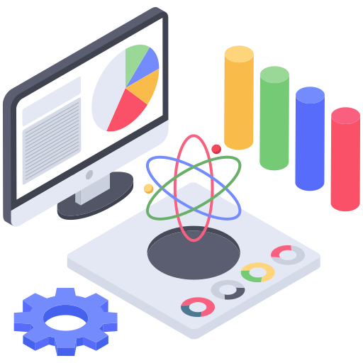
Topic 2 of 6
Current State of ML
87% of Data Science projects do not make it to production. (Source)
Why?

Slide 5
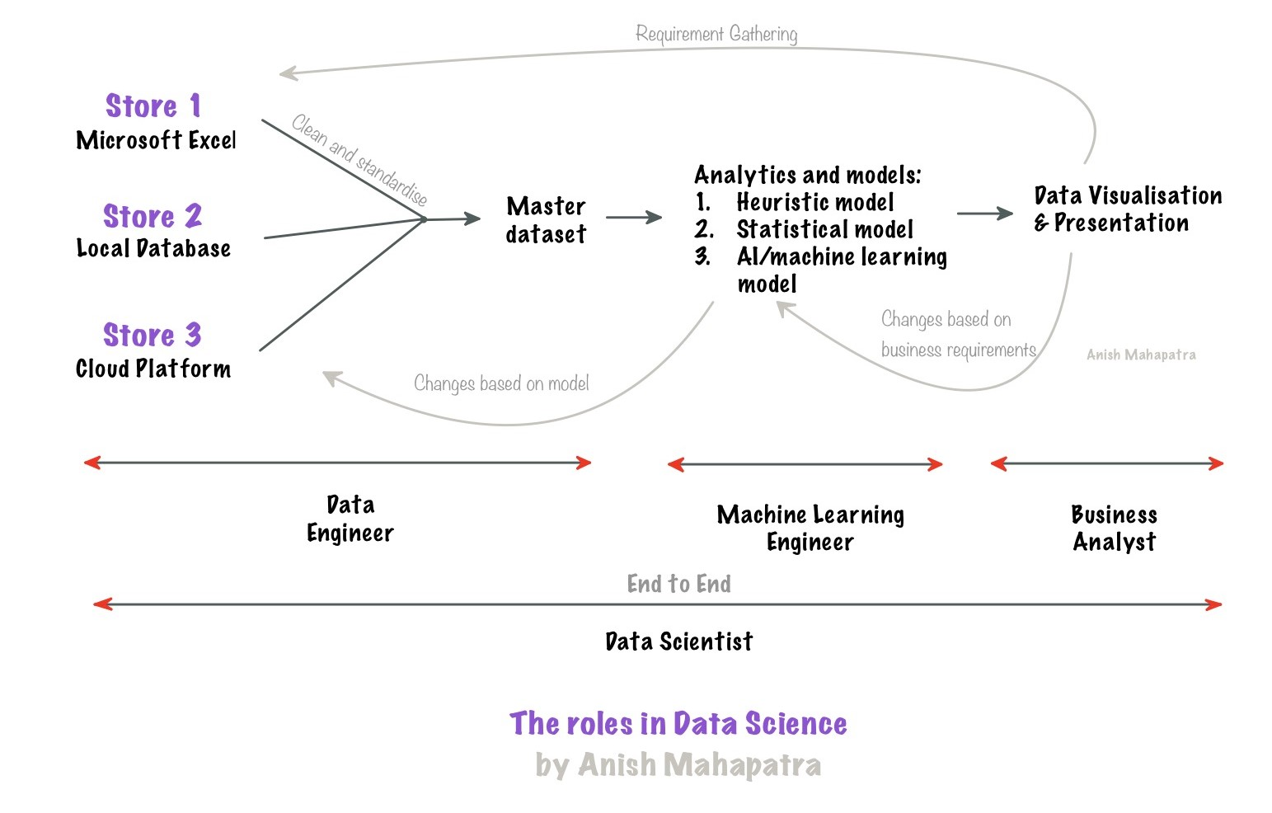
Topic 2 of 6
Current State of ML

Slide 6




Topic 2 of 6
Roles in Data Science
01
02
03
04
Data Engineer
Data Scientist
Machine Learning Engineer
Business Analyst
Data Movement, Building Data pipelines, Quality of Data, Data Governance
Data Wrangling, Feature Engineering, Experimentation, Hypothesis Testing, Scaling from prototype to production
Experimentation, Combination of ML and Engineering applications, Deployment, Model observability, Model monitoring
Client communication & management, Dashboarding & Reporting, Visualization, Decision Making
Notes:
Source: https://databricks.com/blog/2020/08/03/modern-industrial-iot-analytics-on-azure-part-1.html

Slide 7
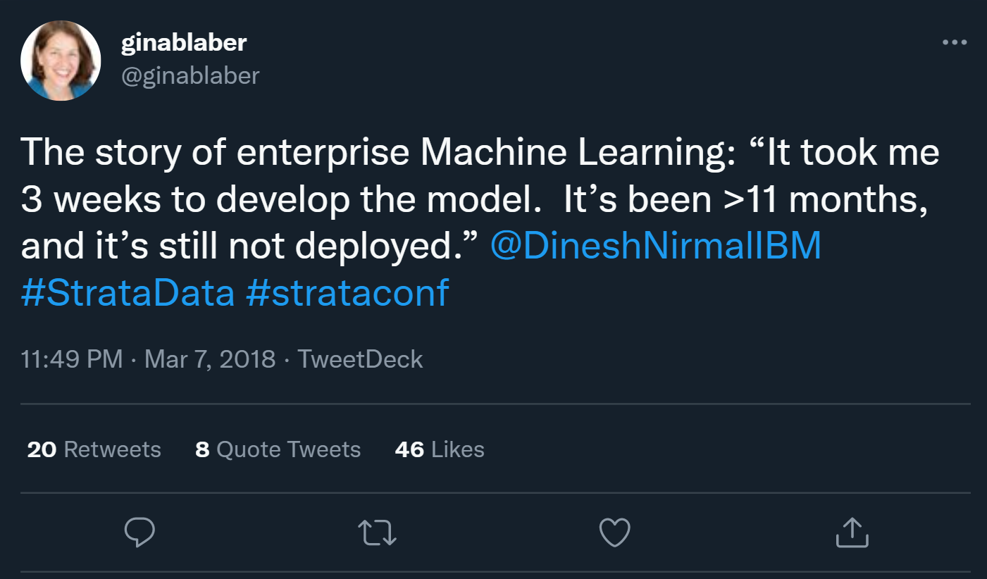
Topic 2 of 6
Current State of Enterprise ML
Source: @ginablaber (Twitter)
Notes:
Source: https://cloud.google.com/architecture/mlops-continuous-delivery-and-automation-pipelines-in-machine-learning

Slide 8

Topic 2 of 6
Current State of Enterprise ML
Notes:
Source: https://cloud.google.com/architecture/mlops-continuous-delivery-and-automation-pipelines-in-machine-learning

Slide 9
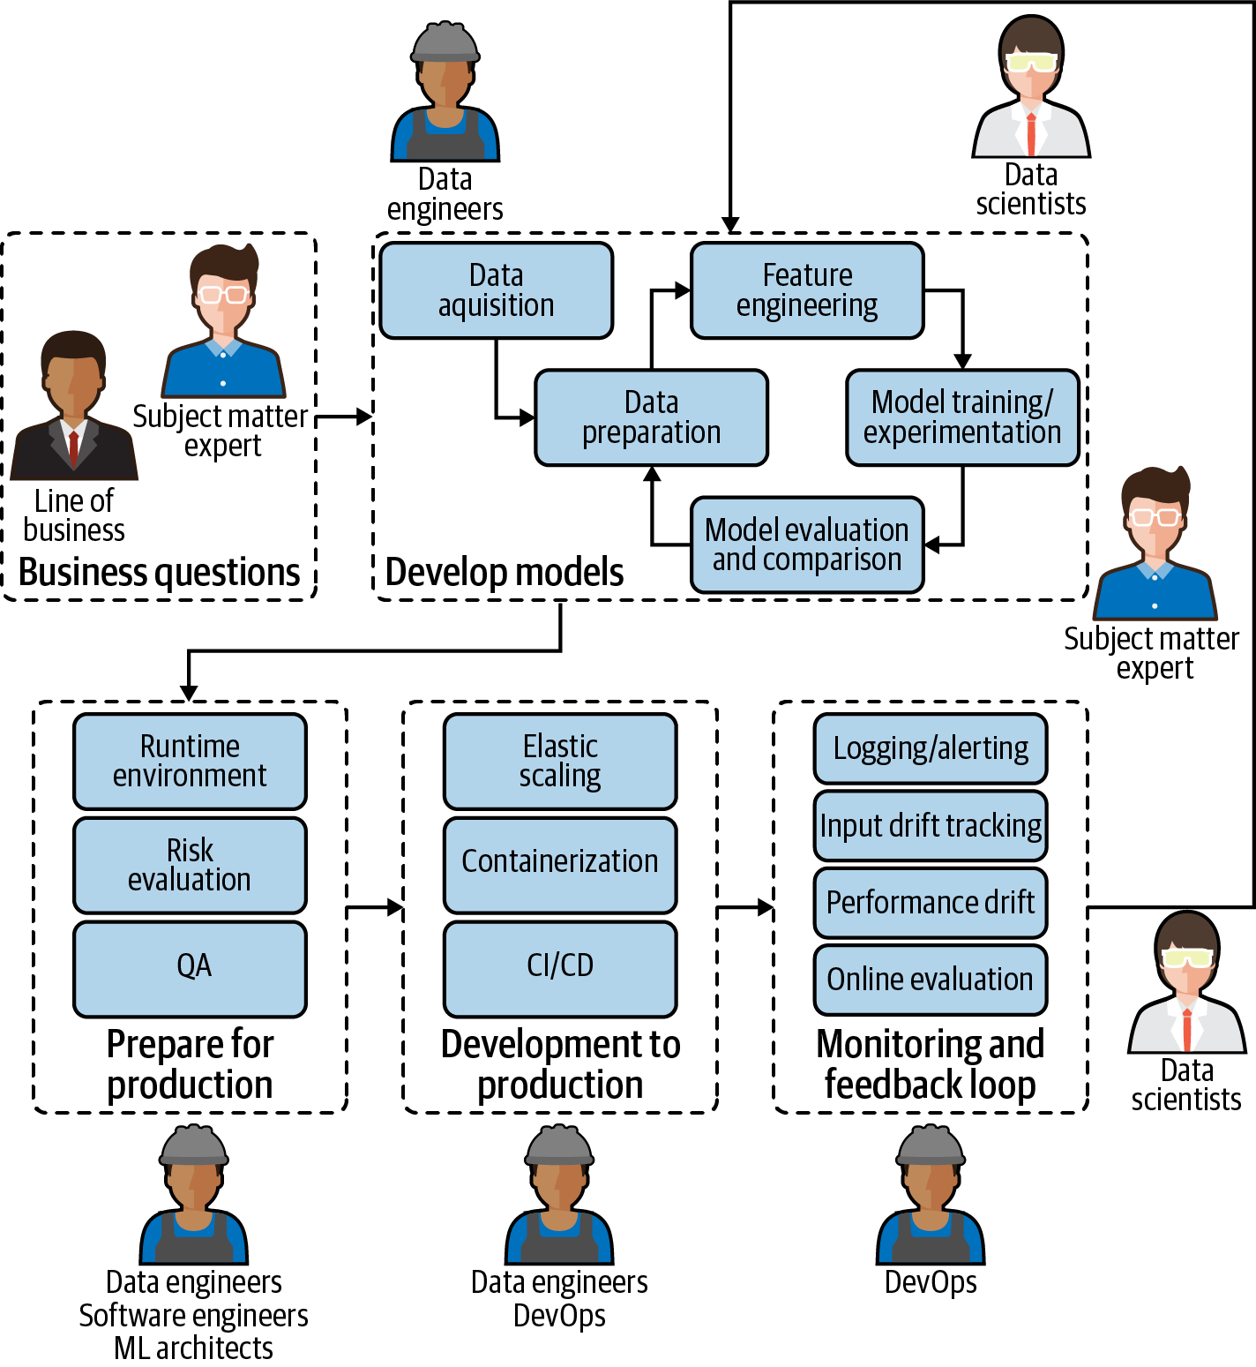
Topic 2 of 6
Future State of ML
Source: O’Reilly
Notes:
Source: https://cloud.google.com/architecture/mlops-continuous-delivery-and-automation-pipelines-in-machine-learning

Slide 10
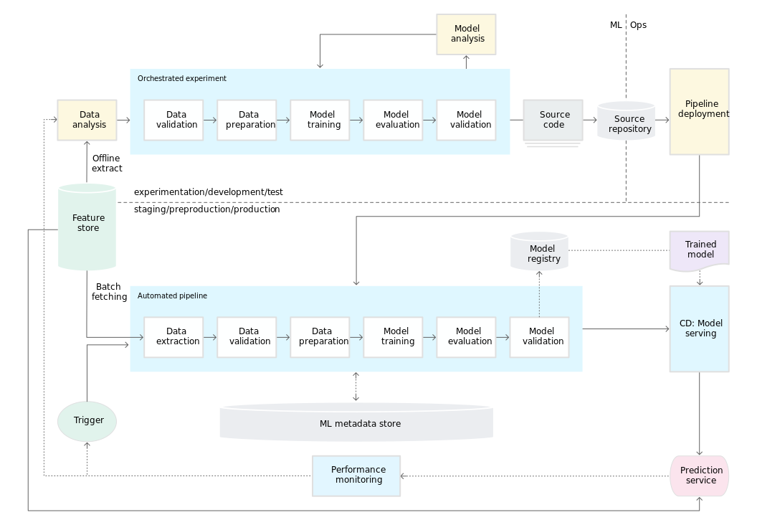
Topic 2 of 6
Future State of Enterprise ML
Source: MLOps Continuous delivery and automation pipelines in Machine Learning by Google Cloud:
Notes:
Source: https://cloud.google.com/architecture/mlops-continuous-delivery-and-automation-pipelines-in-machine-learning

Slide 11
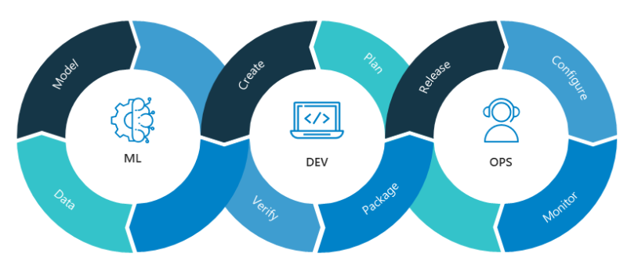



Topic 4 of 6
Top paying roles in the future
MLOps
Machine Learning operationalization
Digital Transformation
Intelligent manufacturing practices that interact with people, new technologies and innovation
Includes automation, cloud, robotics, Big Data, IoT, security
Data Driven Industrial 4.0
Technical, Quality, risk & safety, Management & entrepreneurship, Innovation

Slide 12
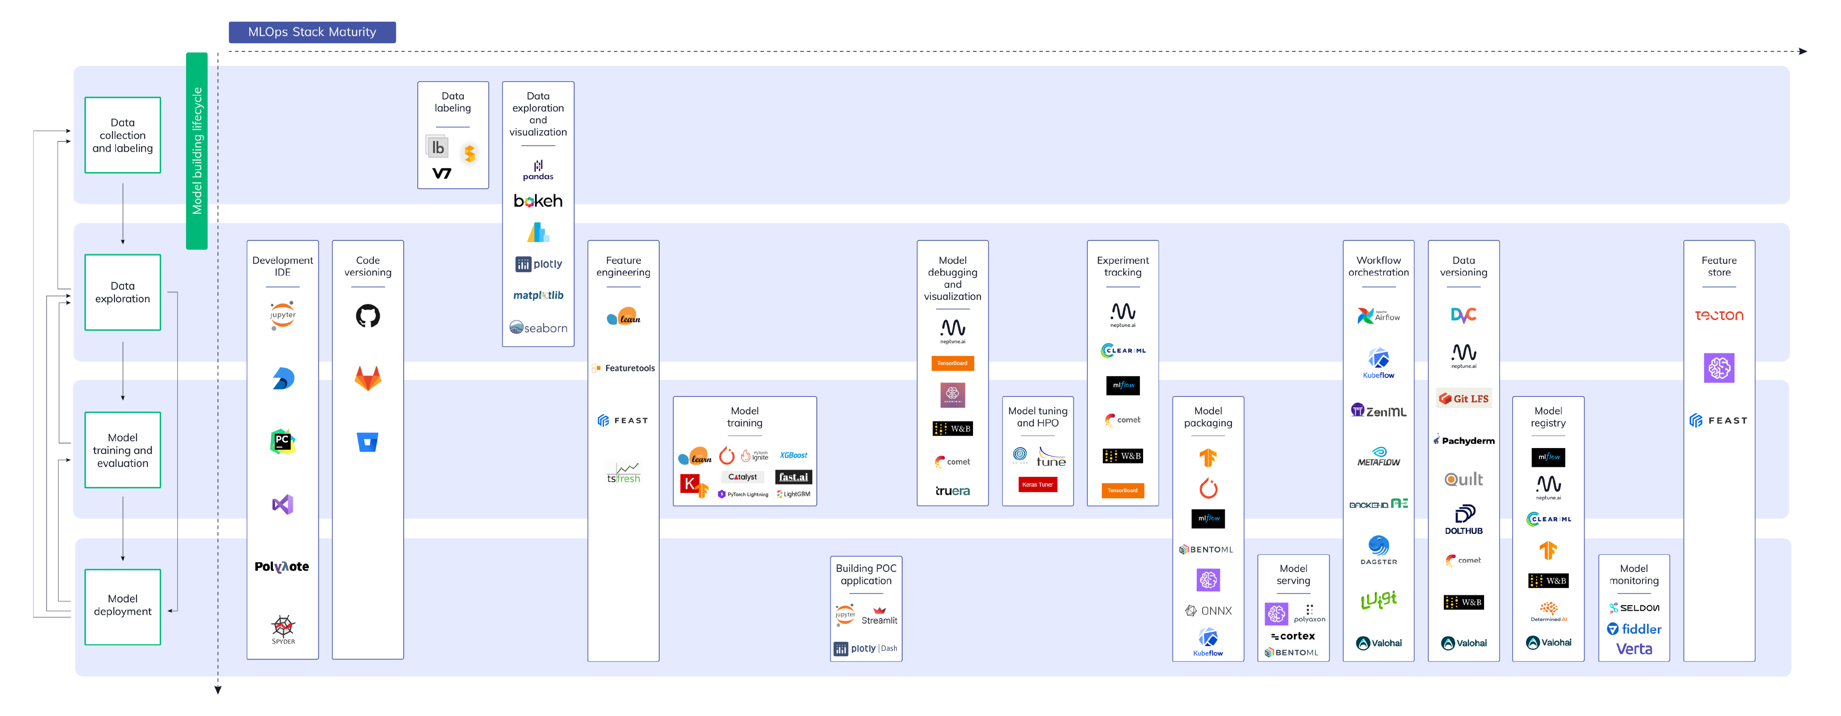
Topic 5 of 6
Tools & Technologies for MLOps

Slide 13
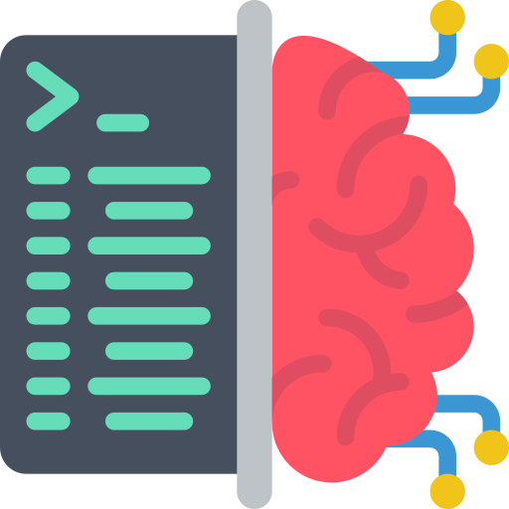
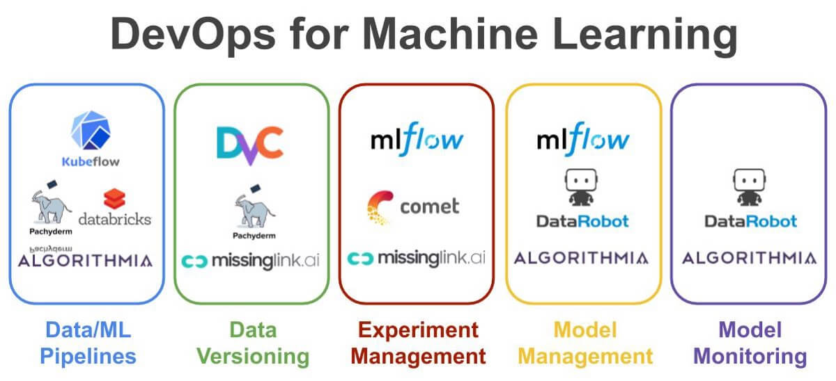


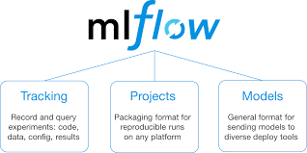
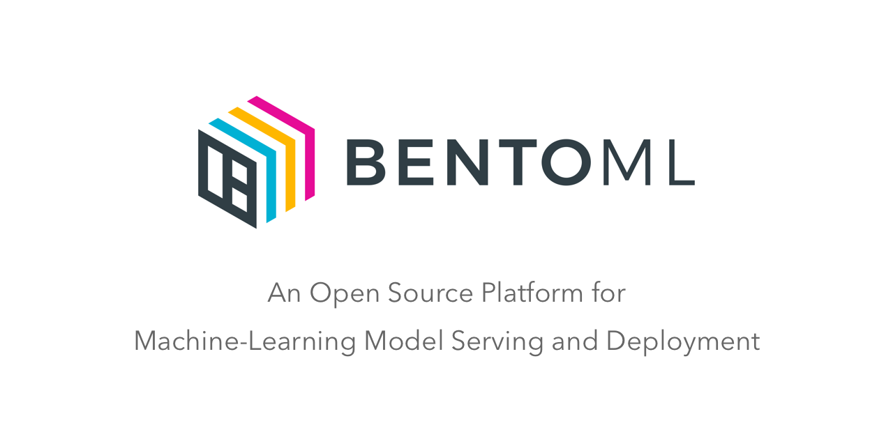



Topic 4 of 6
Tools & Technologies for MLOps
How to perform MLOps?
Create reproducible ML pipelines (Automation)
Enable reusable ML environments
Register, package and deploy models
Capture governance data for end-to-end lifecycle
Generate Alerts
Monitor ML Applications (efficacy, infrastructure)
Automate the end-to-end ML lifecycle
Audit trail creation for all artifacts (asset integrity and regulatory requirements)

Slide 14
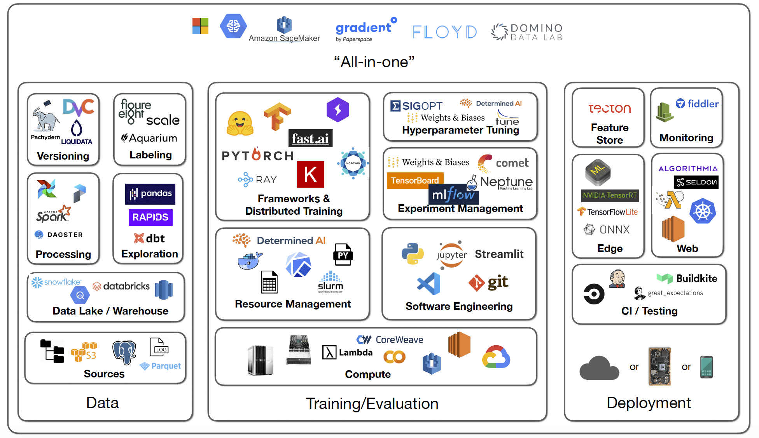
Topic 5 of 6
Tools & Technologies for MLOps

Slide 15
Key Takeaways
01
Introduction
02
Current State of ML
03
Future State of ML
04
Top paying roles in different domains
05
Tools & Technologies for MLOps

Slide 16

Careers in Machine Learning Ops
Anish Mahapatra
Let’s Talk!
LinkedIn: www.linkedin.com/in/anishmahapatra
Email: anishmahapatra01@gmail.com

Slide 17



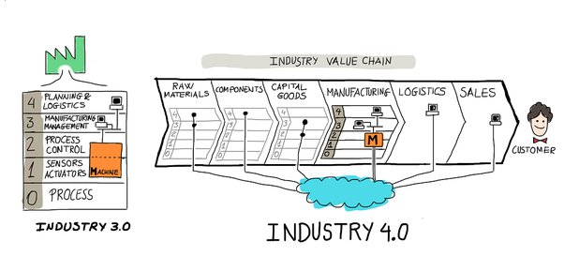

Topic 2 of 6
The Four Industrial Revolutions
01
02
03
Industry 1.0
Industry 2.0
Industry 3.0
Mechanization and the introduction of steam and water power
Mass production assembly lines using electrical power
Automated production, computers, IT systems and robotics
04
Industry 4.0
The Smart Factory, Autonomous systems, IoT, Machine Learning
Notes:
In Industry 3.0, we automate processes using logic processors and information technology. These processes often operate largely without human interference, but there is still a human aspect behind it. Where Industry 4.0 comes in is with the availability and use of vast quantities of data on the production floor.

Slide 18



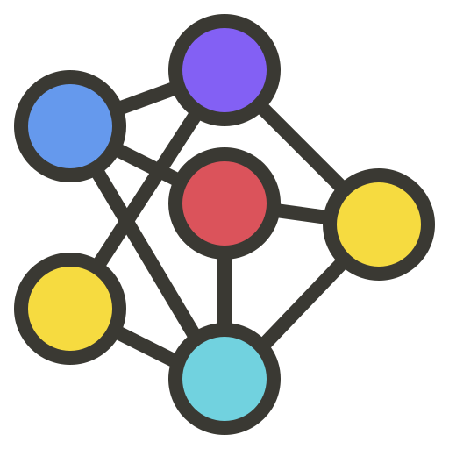



Topic 3 of 6
Applications of Industry 4.0
Cognitive Computing
Advanced Robotics
Use of computerized models to simulate the human though process
Advanced robots have superior perception, integrability, adaptability and mobility. This permits faster setup, commissioning and reconfiguration
Machine To Machine (M2M)
3D Printing
Enables Networked devices to exchange information and perform actions without the manual assistance
3D Printing helps increase supply chain flexibility, helping eliminate the need for expensive tools and fixtures
RFID Technologies / IoT
Cloud Computing & Cyber Security
RFID is used to automate processes and utilize technology to connect systems
Cloud computing & Cyber security are the foundation of smart factories

Slide 19





Topic 4 of 6
How Machine Learning play a part?
01
02
03
Network Threats
Safe Browsing
Endpoint Malware protection
Monitor Network for Anomalies, ML allows us to identify detection of insider threats, unknown malware, policy violations
ML can predict “bad neighborhoods” by analyzing internet activity. It identifies attack infrastructures
Algorithms can detect never-before-seen malware attacks that is trying to run on the endpoints
04
05
Protect Data in the Cloud
Detect Malware in encrypted traffic
Machine Learning can identify suspicious cloud app login activity, detecting location-based anomalies, and conducting IP reputation analysis
Analyze encrypted traffic data elements in common network telemetry. Malicious patterns can be identified without decrypting
Notes:
Source: https://www.cisco.com/c/en/us/products/security/machine-learning-security.html#~how-ml-helps-security

Slide 20



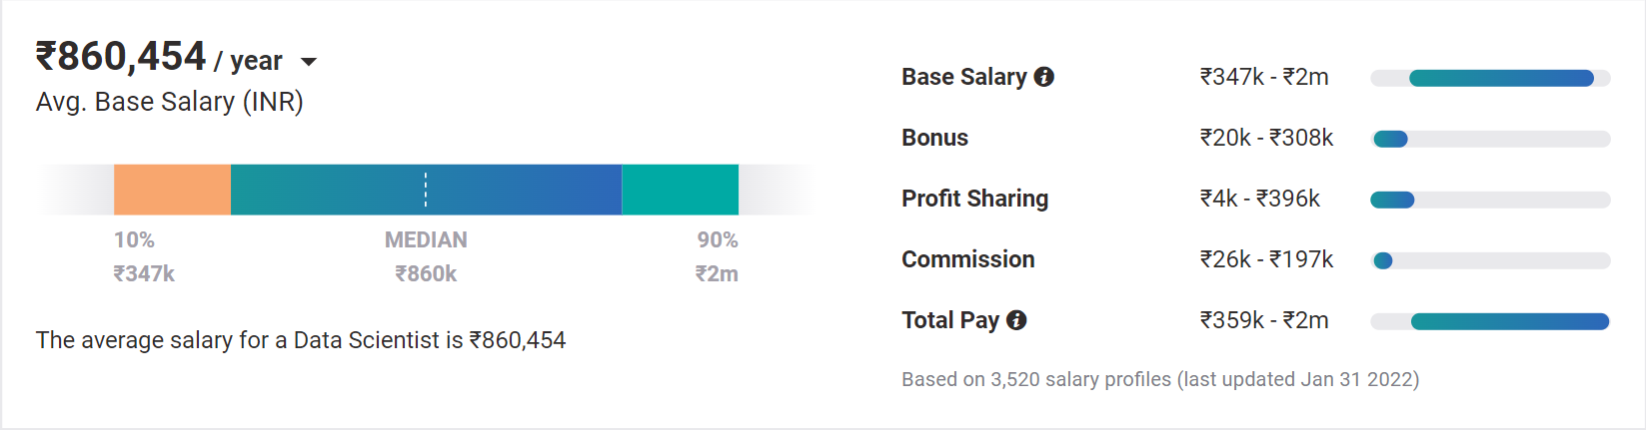
Topic 4 of 6
Why choose Data Science?
01
02
03
Relevance in the future
Business & Technology
Industry-Agnostic
Companies are building and growing in Data and it is the future.
Data Science is a combination of Business, Math and Technology, so growth can be in business / technology
Use your existing knowledge / domain / technology expertise with a data-edge
04
Extremely High Market Demand
Supply-Demand mismatch means companies are willing to pay more
Notes:
Source:https://www.payscale.com/research/IN/Job=Data_Scientist/Salary

Slide 21
Topic 4 of 6
How to leverage a degree to get there?
01
02
03
Set Target
Talk to people
Build LinkedIn Profile
Understand the Data Field,
Understand roles & responsibilities,
Look at a 5-year path
Talk to people who are already doing what you want to do
Add certifications, participate in competitions, do simple projects, look at how the best of the best do it
06
05
04
Build Collaterals & Profile (30%)
Globally Accepted Degree (70%)
Explore Certifications
Multiple certifications don’t help, the quality of it does.
GitHub, LinkedIn,
Medium, Brand Profiling
Globally recognized degree, Degree Accepted by MNCs,
Possibility of PhD later,
Alumni Status
Bonus - WES Certification, Teachers from the industry
Notes:
All we care about is how to get a job, let me tell you how to leverage MSc to get a job!

Slide 22







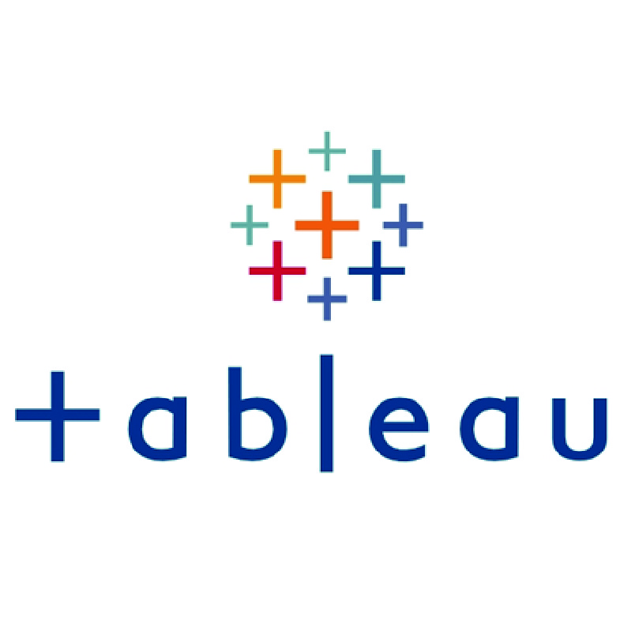





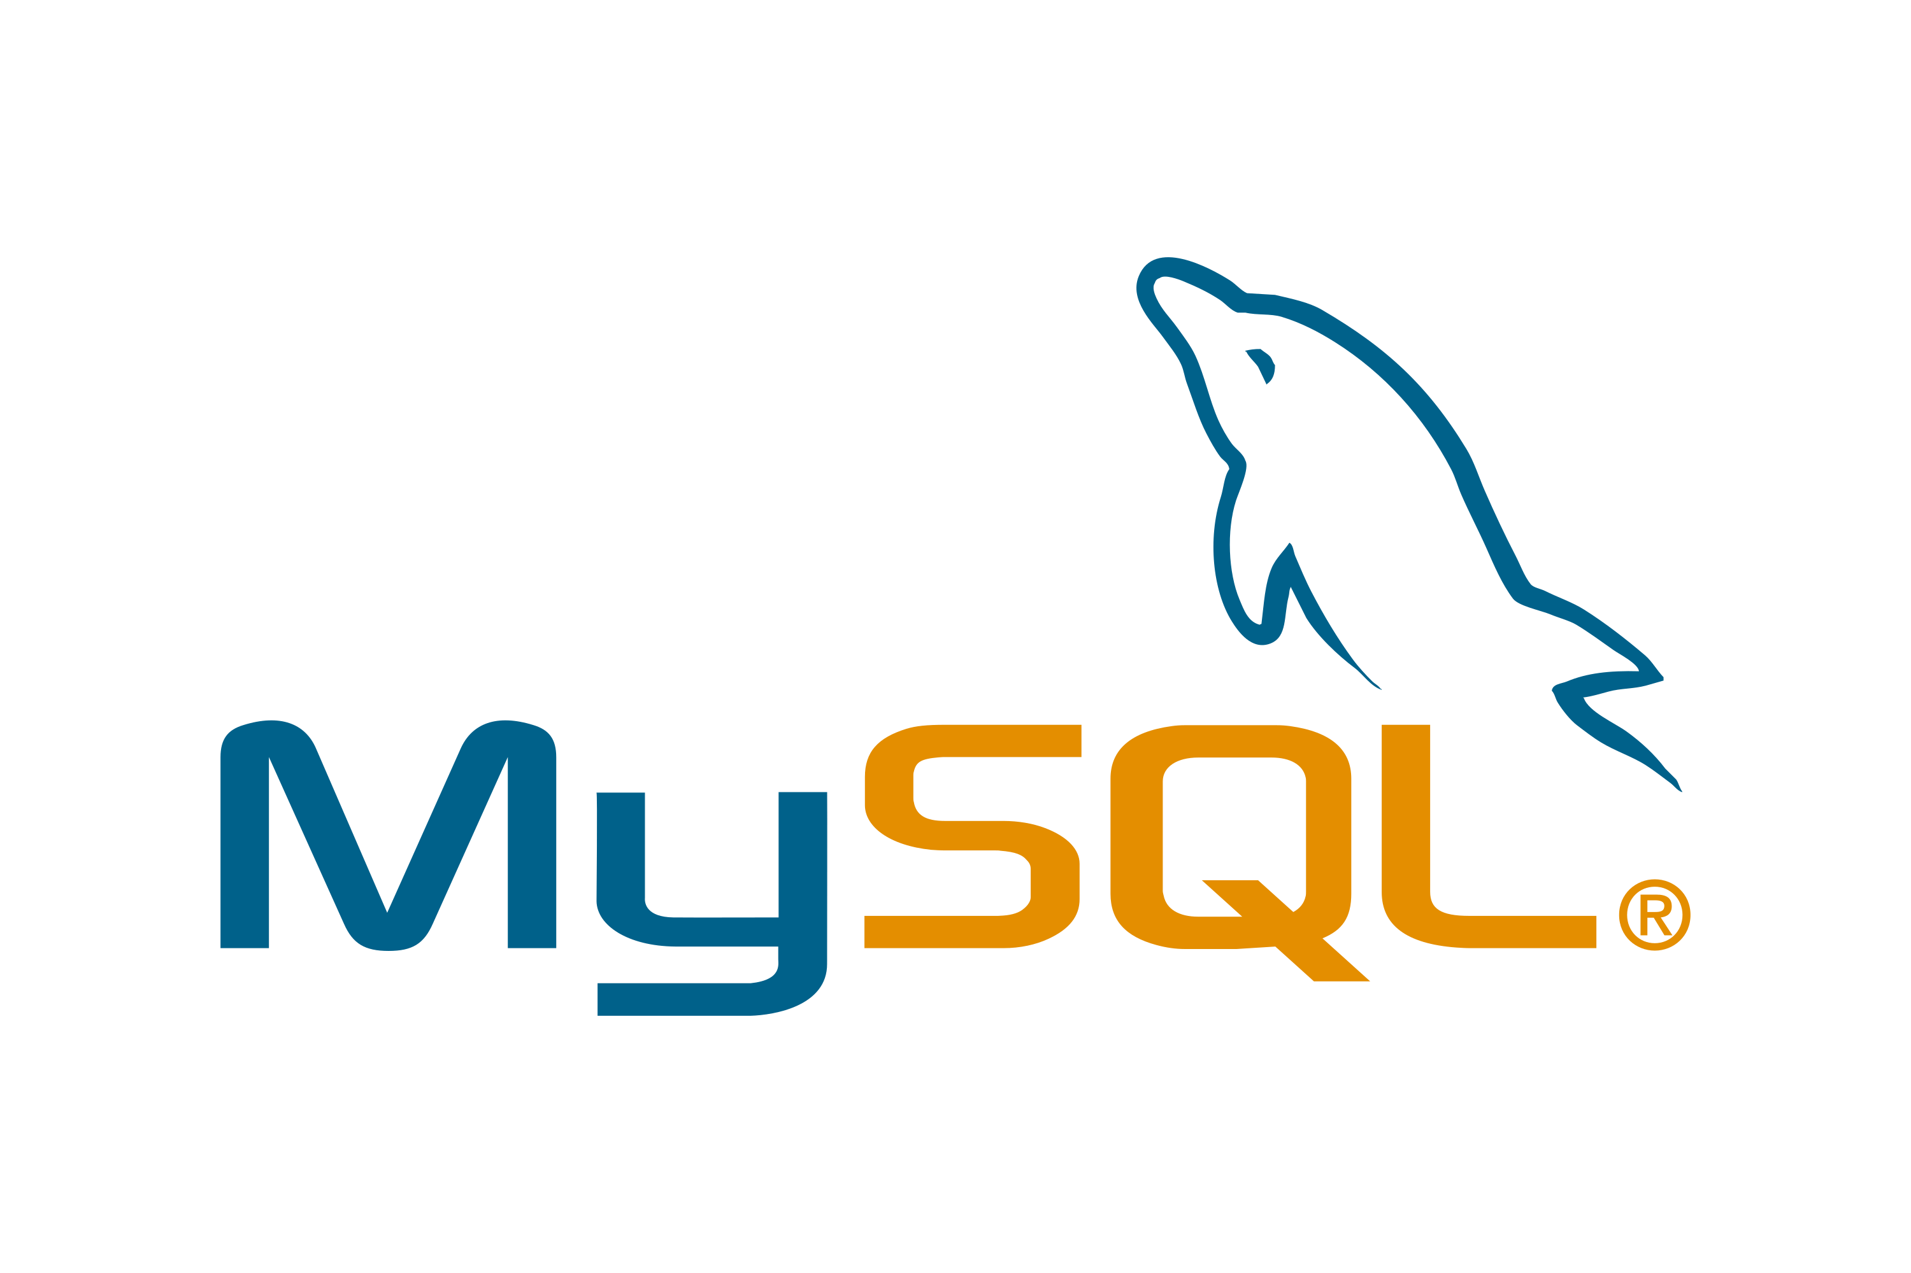

Topic 5 of 6
Tools & Technologies in Data Science
Data Engineer
Machine Learning Engineer
Business Analyst
Data Scientist

Slide 23






Topic 5 of 6
Resume Optimization

